Slide 1

Chapter 3. Data Processing
Meng Jiang
CS412 Summer 2017:
Introduction to Data Mining

Slide 2
Why? Data Quality Issues
Measures for data quality: A multidimensional view
Accuracy: correct or wrong, accurate or not
Believability: how trustable the data are correct?
Completeness: not recorded, unavailable, …
Consistency: some modified but some not, dangling, …
Timeliness: timely update?
Interpretability: how easily the data can be understood?

Slide 3
Data Preprocessing
Data cleaning
Data integration
Data reduction
Dimensionality reduction

Slide 4
Data Cleaning
Data in the Real World Is Dirty: Lots of potentially incorrect data, e.g., instrument faulty, human or computer error, and transmission error
Incomplete: lacking attribute values, lacking certain attributes of interest, or containing only aggregate data
e.g., Occupation = “ ” (missing data)
Noisy: containing noise, errors, or outliers
e.g., Salary = “−10” (an error)
Inconsistent: containing discrepancies in codes or names, e.g.,
Age = “42”, Birthday = “03/07/2010”
Was rating “1, 2, 3”, now rating “A, B, C”
Intentional (e.g., disguised missing data)
Jan. 1 as everyone’s birthday?

Slide 5
Incomplete (Missing) Data
Data is not always available
E.g., many tuples have no recorded value for several attributes, such as customer income in sales data
Missing data may be due to
Equipment malfunction
Inconsistent with other recorded data and thus deleted
Data were not entered due to misunderstanding
Certain data may not be considered important at the time of entry
Missing data may need to be inferred

Slide 6
How to Handle Missing Data?
Ignore the tuple: usually done when class label is missing (when doing classification) — not effective when the % of missing values per attribute varies considerably
Fill in the missing value manually: tedious + infeasible?
Fill in it automatically with
a global constant : e.g., “unknown”, a new class?!
the attribute mean
the attribute mean for all samples belonging to the same class: smarter
the most probable value: inference-based such as Bayesian formula or decision tree

Slide 7
Noisy Data
Noise: random error or variance in a measured variable
Incorrect attribute values may be due to
Faulty data collection instruments
Data transmission problems
Technology limitation
Inconsistency in naming convention
Other data problems
Duplicate records
Incomplete data
Inconsistent data
Notes:
Sensors

Slide 8
How to Handle Noisy Data?
Binning
First sort data and partition into (equal-frequency) bins
Then one can smooth by bin means, smooth by bin median, smooth by bin boundaries, etc.
Regression
Smooth by fitting the data into regression functions
Clustering
Detect and remove outliers
Semi-supervised: Combined computer and human inspection
Detect suspicious values and check by human (e.g., deal with possible outliers)

Slide 9
Data Preprocessing
Data cleaning
Data integration
Data reduction
Dimensionality reduction

Slide 10
Data Integration
Data integration
Combining data from multiple sources into a coherent store
Schema integration: e.g., A.cust-id ≡ B.cust-#
Integrate metadata from different sources
Entity identification:
Identify real world entities from multiple data sources, e.g., Bill Clinton = William Clinton
Detecting and resolving data value conflicts
For the same real world entity, attribute values from different sources are different
Possible reasons: different representations, different scales, e.g., metric vs. British units

Slide 11
Handling Redundancy in Data Integration
Redundant data occur often when integration of multiple databases
Object identification: The same attribute or object may have different names in different databases
Derivable data: One attribute may be a “derived” attribute in another table, e.g., annual revenue
Redundant attributes may be able to be detected by correlation analysis and covariance analysis
Careful integration of the data from multiple sources may help reduce/avoid redundancies and inconsistencies and improve mining speed and quality

Slide 12
Correlation Analysis
 | Play chess | Not play chess | Sum (row)
Like science fiction |  |  | 450
Not like science fiction |  |  | 1050
Sum(col.) | 300 | 1200 | 1500

Slide 13
Correlation Analysis
 | Play chess | Not play chess | Sum (row)
Like science fiction | 90 | 360 | 450
Not like science fiction | 210 | 840 | 1050
Sum(col.) | 300 | 1200 | 1500
How to derive 90?
450/1500 * 300 = 90

Slide 14
Correlation Analysis
 | Play chess | Not play chess | Sum (row)
Like science fiction | 250 (90) | 200 (360) | 450
Not like science fiction | 50 (210) | 1000 (840) | 1050
Sum(col.) | 300 | 1200 | 1500

Slide 15
Correlation Analysis (for Categorical Data)
Χ² (chi-square) test:
Null hypothesis: The two distributions are independent
The cells that contribute the most to the Χ² value are those whose actual count is different from the expected count
The larger the Χ² value, the more the null hypothesis of independence is rejected, and the more likely the variables are related
 | Play chess | Not play chess | Sum (row)
Like science fiction | 250 (90) | 200 (360) | 450
Not like science fiction | 50 (210) | 1000 (840) | 1050
Sum(col.) | 300 | 1200 | 1500

Slide 16
Example: Chi-Square Calculation
 | Play chess | Not play chess | Sum (row)
Like science fiction | 250 (90) | 200 (360) | 450
Not like science fiction | 50 (210) | 1000 (840) | 1050
Sum(col.) | 300 | 1200 | 1500
Χ² (chi-square) calculation (numbers in parenthesis are expected counts calculated based on the data distribution in the two categories)
It shows that like_science_fiction and play_chess are correlated.
We can reject the null hypothesis of independence at a confidence level of 0.001.

Slide 17
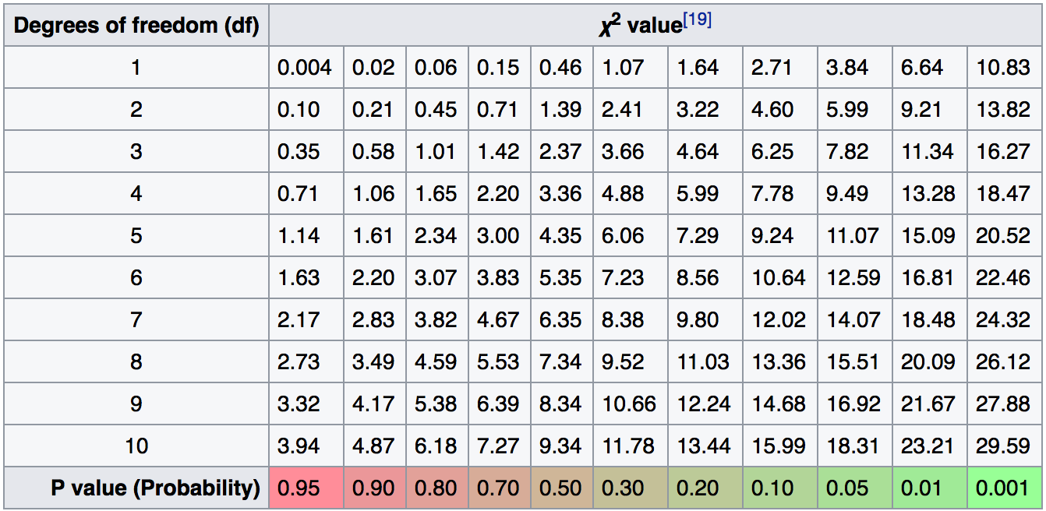
Example: Chi-Square Calculation

Slide 18
Correlation Analysis (for Categorical Data)
Χ² (chi-square) test:
Null hypothesis: The two distributions are independent
The cells that contribute the most to the Χ² value are those whose actual count is different from the expected count
The larger the Χ² value, the more the null hypothesis of independence is rejected, and the more likely the variables are related
Note: Correlation does not imply causality
# of hospitals and # of car-theft in a city are correlated
Both are causally linked to the third variable: population

Slide 19
Variance for Single Variable (for Numerical Data)
The variance of a random variable X provides a measure of how much the value of X deviates from the mean or expected value of X:
where σ² is the variance of X, σ is called standard deviation
µ is the mean, and µ = E[X] is the expected value of X
That is, variance is the expected value of the square deviation from the mean
It can also be written as:

Slide 20
Covariance for Two Variables
Covariance between two variables X₁ and X₂
where µ₁ = E[X₁] is the respective mean or expected value of X₁; similarly for µ₂
Positive covariance: If σ₁₂ > 0
Negative covariance: If σ₁₂ < 0
Independence: If X₁ and X₂ are independent, σ₁₂ = 0 but the reverse is not true
Some pairs of random variables may have a covariance 0 but are not independent
Only under some additional assumptions (e.g., the data follow multivariate normal distributions) does a covariance of 0 imply independence

Slide 21
Example: Calculation of Covariance
Suppose two stocks X₁ and X₂ have the following values in one week:
(2, 5), (3, 8), (5, 10), (4, 11), (6, 14)
Question: If the stocks are affected by the same industry trends, will their prices rise or fall together?
Covariance formula
Its computation can be simplified as:
E(X₁) = (2 + 3 + 5 + 4 + 6) / 5 = 20/5 = 4
E(X₂) = (5 + 8 + 10 + 11 + 14) / 5 = 48/5 = 9.6
σ₁₂ = (2×5 + 3×8 + 5×10 + 4×11 + 6×14) / 5 − 4 × 9.6 = 4
Thus, X₁ and X₂ rise together since σ₁₂ > 0

Slide 22
Correlation between Two Numerical Variables
Correlation between two variables X1 and X2 is the standard covariance, obtained by normalizing the covariance with the standard deviation of each variable
If ρ12 > 0: A and B are positively correlated (X1’s values increase as X2’s)
The higher, the stronger correlation
If ρ12 = 0: independent (under the same assumption as discussed in co-variance)
If ρ12 < 0: negatively correlated

Slide 23
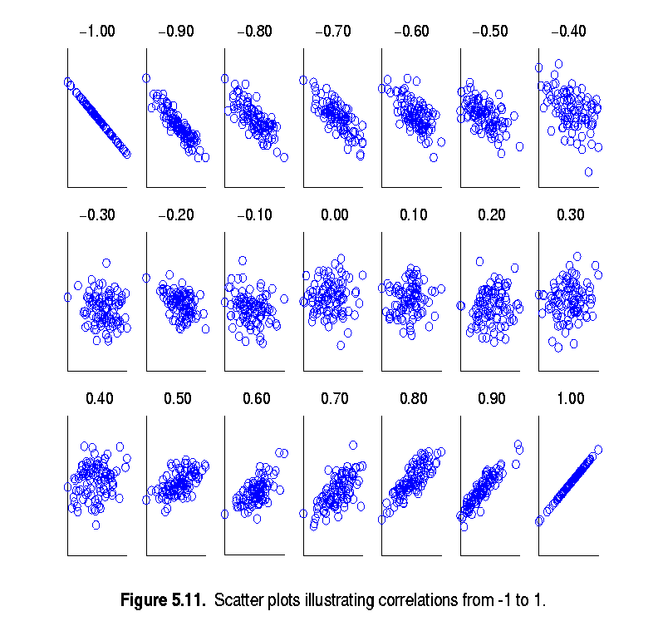
Visualizing Changes of Correlation Coefficient
Correlation coefficient value range: [–1, 1]
A set of scatter plots shows sets of points and their correlation coefficients changing from –1 to 1

Slide 24
Covariance Matrix
The variance and covariance information for the two variables X₁ and X₂ can be summarized as 2 * 2 covariance matrix as
Generalizing it to d dimensions, we have,

Slide 25
Announcement
Assignment 1 is out!
Due date: June 15th.
Compass
TAs: Xuan Wang (xwang174@illinois.edu) and Sheng Wang (swang141@illinois.edu)

Slide 26

Chapter 3. Data Processing
Meng Jiang
CS412 Summer 2017:
Introduction to Data Mining

Slide 27
Data Preprocessing
Data cleaning
Data integration
Data reduction
Reduce by data objects
Dimensionality reduction
Reduce by dimensions and attributes

Slide 28
Data Reduction
Data reduction
Obtain a reduced representation of the data set
Why? Complex analysis may take a very long time to run on the complete data set
Methods for data reduction
Regression and Log-Linear Models
Histograms, Clustering, Sampling
Data compression

Slide 29
Regression Analysis
Regression analysis: A collective name for techniques for the modeling and analysis of numerical data consisting of values
of a dependent variable (also called response variable or measurement): Y
and of one or more independent variables (also known as explanatory variables or predictors): X, or X₁, X₂, …X_{n}
Parameters are estimated to give a “best fit” of the data
Data: (x₁, y₁)
Fit of the data: (x₁, y₁’)
Ex. y₁’ = x₁ + 1
Y
y₁
y₁’
y = x + 1
x₁
X

Slide 30
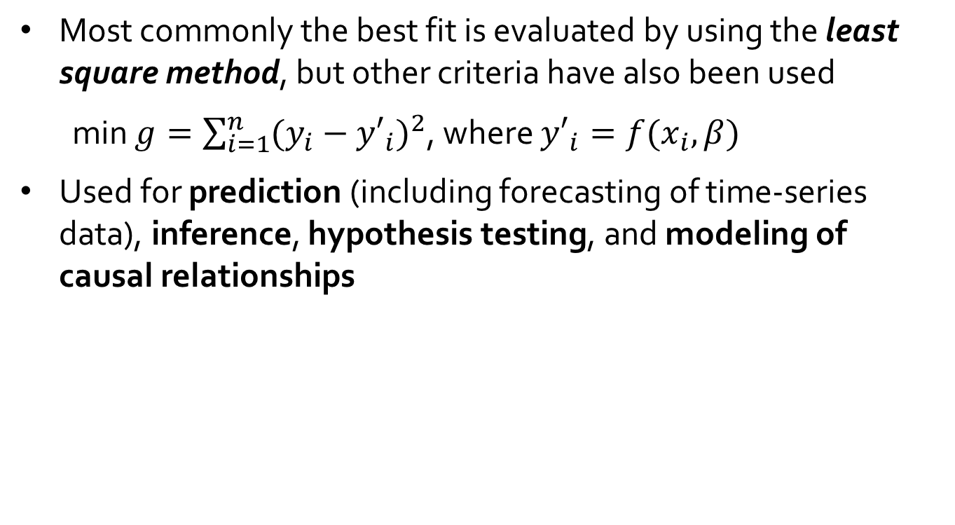
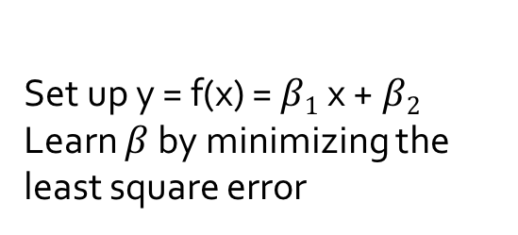
Regression Analysis (cont.)
Most commonly the best fit is evaluated by using the least square method, but other criteria have also been used
min $g=\sum_{i=1}^{n}{{(y_{i}−{y′}_{i})}^{2}}$, where ${y′}_{i}=f(x_{i}, β)$
Used for prediction (including forecasting of time-series data), inference, hypothesis testing, and modeling of causal relationships
Y
y₁
Set up y = f(x) = $β1$x +$β2$
Learn $β$ by minimizing the least square error
y₁’
y = x + 1
x₁
X

Slide 31
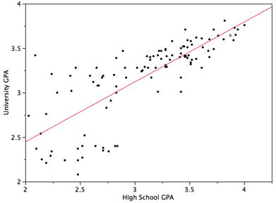
Linear Regression
Linear regression: Y = w X + b
Data modeled to fit a straight line
Often uses the least-square method to fit the line
Two regression coefficients, w and b, specify the line and are to be estimated by using the data at hand

Slide 32
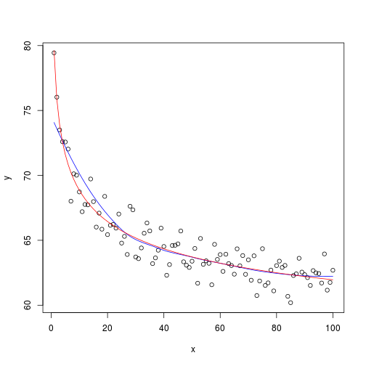
Nonlinear Regression
Nonlinear regression:
Data are modeled by a function which is a nonlinear combination of the model parameters and depends on one or more independent variables

Slide 33
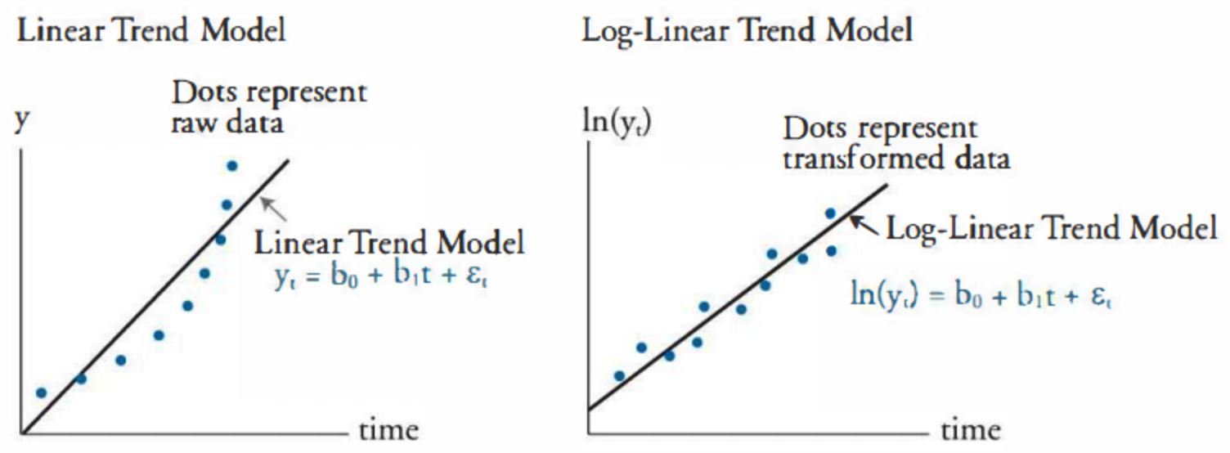
Log-Linear Model
Log-linear model
A math model that takes the form of a function whose logarithm is a linear combination of the parameters of the model

Slide 34
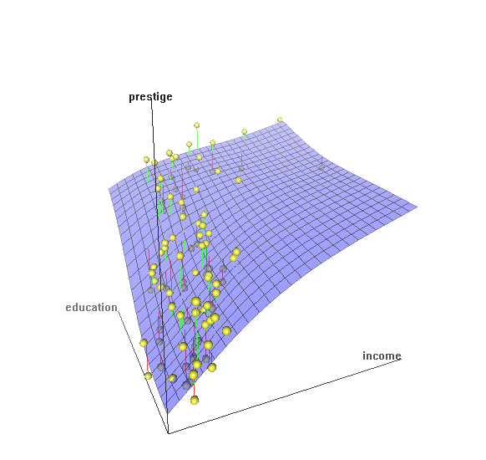
Multiple Regression
Multiple regression: Y = b₀ + b₁ X₁ + b₂ X₂
Allows a response variable Y to be modeled as a linear function of multidimensional feature vector
Many nonlinear functions can be transformed into the above

Slide 35
Histogram Analysis
Divide data into buckets and store average (sum) for each bucket
One popular partitioning rules - Equal-width: equal bucket range
(10,000 , 10,001] = 10,001
…
to
(10,000 , 11,000]
(11,000 , 12,000]
…

Slide 36
Clustering
Partition data set into clusters based on similarity, and store cluster representation (e.g., centroid and diameter) only
Can be very effective if data is clustered but not if data is “smeared”
Can have hierarchical clustering and be stored in multi-dimensional index tree structures
There are many choices of clustering definitions and clustering algorithms
Cluster analysis will be studied in depth in Chapter 10

Slide 37
Sampling
Sampling: obtaining a small sample s to represent the whole data set N
Key principle: Choose a representative subset of the data
Simple random sampling may have very poor performance in the presence of skew
Simple random sampling:
Equal probability of selecting any particular item
Sampling without replacement:
Once an object is selected, it is removed from the population
Sampling with replacement:
A selected object is not removed from the population
Raw Data
SRSWOR
(simple random
sample without
replacement)
SRSWR

Slide 38
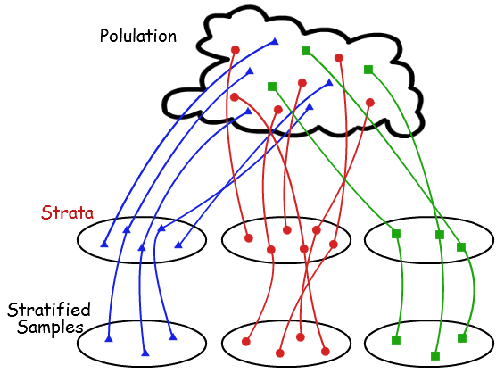
Stratified Sampling
Stratified sampling
Partition (or cluster) the data set, and draw samples from each partition (proportionally, i.e., approximately the same percentage of the data)

Slide 39
Recall: Data Reduction
Data reduction
Obtain a reduced representation of the data set
Why? Complex analysis may take a very long time to run on the complete data set
Methods for data reduction
Regression and Log-Linear Models
Histograms, Clustering, Sampling
Data compression

Slide 40
Parametric vs. Non-Parametric Data Reduction Methods
Parametric methods (e.g., regression)
Assume the data fits some model, estimate model parameters, store only the parameters, and discard the data (except possible outliers)
Non-parametric methods
Do not assume models
Major families: histograms, clustering, sampling, …

Slide 41
Data Compression
String compression
There are extensive theories and well-tuned algorithms
Typically lossless, but only limited manipulation is possible without expansion
Audio/video compression
Typically lossy compression, with progressive refinement
Sometimes small fragments of signal can be reconstructed without reconstructing the whole
Data reduction and dimensionality reduction may also be considered as forms of data compression
Original Data
Compressed
Data
lossless
Original Data
Approximated
lossy
Lossy vs. lossless compression

Slide 42
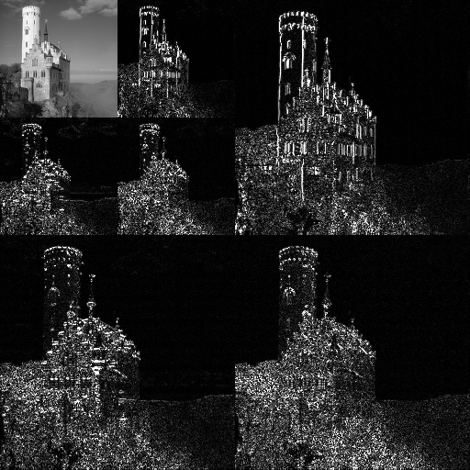
Wavelet Transform: A Data Compression Technique
Wavelet Transform
Decomposes a signal into different frequency subbands
Applicable to n-dimensional signals
Data are transformed to preserve relative distance between objects at different levels of resolution
Allow natural clusters to become more distinguishable
Used for image compression

Slide 43
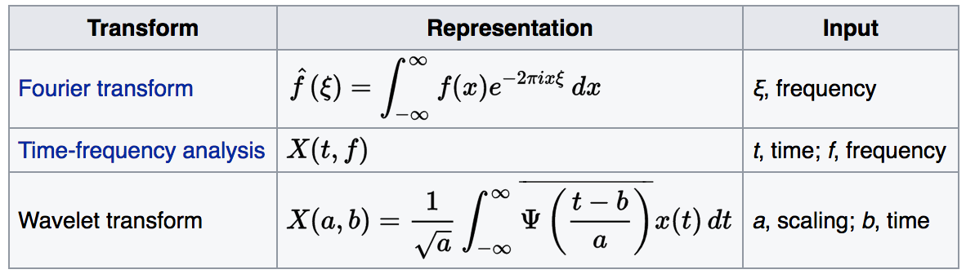
Wavelet Transformation
Discrete wavelet transform (DWT) for linear signal processing, multi-resolution analysis
Compressed approximation: Store only a small fraction of the strongest of the wavelet coefficients
Similar to discrete Fourier transform (DFT), but better lossy compression, localized in space

Slide 44
Normalization
Min-max normalization: to [new_min_{A}, new_max_{A}]
Ex. Let income range $12,000 to $98,000 normalized to [0.0, 1.0]
Then $73,600 is mapped to

Slide 45
Normalization (cont.)
Min-max normalization: to [new_min_{A}, new_max_{A}]
Ex. Let income range $12,000 to $98,000 normalized to [0.0, 1.0]
Then $73,000 is mapped to
Z-score normalization (μ: mean, σ: standard deviation):
Ex. Let μ = 54,000, σ = 16,000. Then
Normalization by decimal scaling
Z-score: The distance between the raw score and the population mean in the unit of the standard deviation
Where j is the smallest integer such that Max(|ν’|) < 1

Slide 46
Data Preprocessing
Data cleaning
Data integration
Data reduction
Dimensionality reduction

Slide 47
Dimensionality Reduction
Curse of dimensionality
When dimensionality increases, data becomes increasingly sparse
Density and distance between points, which is critical to clustering, outlier analysis, becomes less meaningful
The possible combinations of subspaces will grow exponentially
Dimensionality reduction
Reducing the number of random variables under consideration, via obtaining a set of principal variables
Advantages of dimensionality reduction
Avoid the curse of dimensionality
Help eliminate irrelevant features and reduce noise
Reduce time and space required in data mining
Allow easier visualization

Slide 48
Dimensionality Reduction Techniques
Dimensionality reduction methodologies
Feature selection (FS): Find a subset of the original variables (or features, attributes)
Feature extraction (FE): Transform the data in the high-dimensional space to a space of fewer dimensions
Some typical dimensionality methods
FE: Principal Component Analysis
FS: Attribute Subset Selection = Attribute Selection

Slide 49

Principal Component Analysis (PCA)
PCA: A statistical procedure that uses an orthogonal transformation to convert a set of observations of possibly correlated variables into a set of values of linearly uncorrelated variables called principal components
The original data are projected onto a much smaller space, resulting in dimensionality reduction (e.g., n=3 to k=2)

Slide 50
PCA (cont.)
Given N data vectors from n-dimensions, find k ≤ n orthogonal vectors (principal components) best used to represent data
n
k
...
N
n

Slide 51
PCA (cont.)
Given N data vectors from n-dimensions, find k ≤ n orthogonal vectors (principal components) best used to represent data
Normalize input data: Each attribute falls within the same range
Compute k orthonormal (unit) vectors, i.e., principal components
Each input data (vector) is a linear combination of the k principal component vectors
normalized eigenvector
n
k
k
...
N
n
N

Slide 52
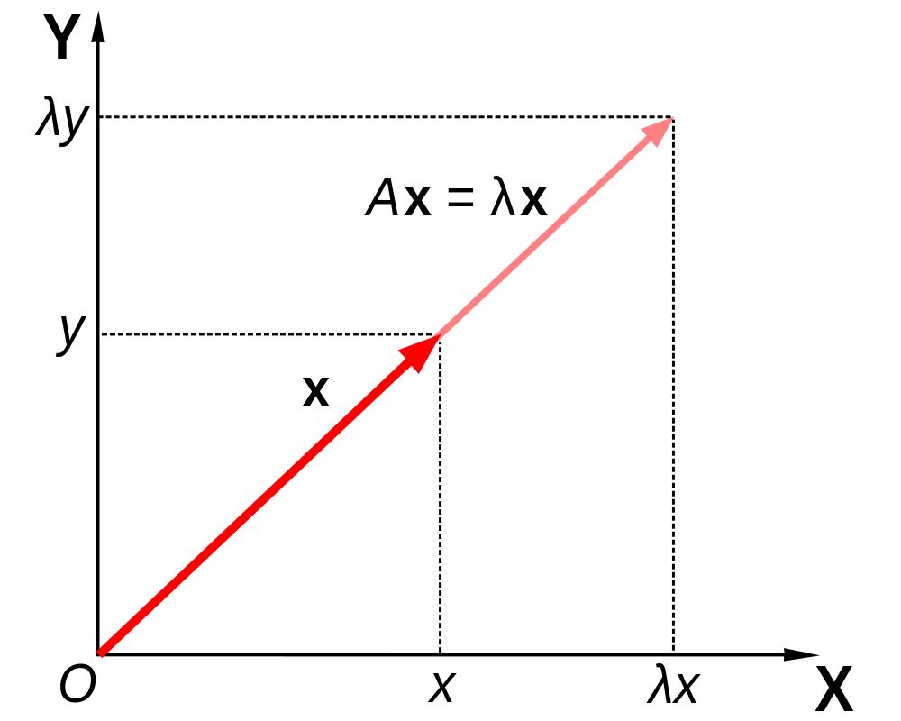
Eigenvectors (cont.)
For a square matrix A (n*n), find the eigenvector x (n*1).
A represents the linear transformation (from n to n)
Matrix A acts by stretching the vector x, not changing its direction, so x is an eigenvector of A.

Slide 53
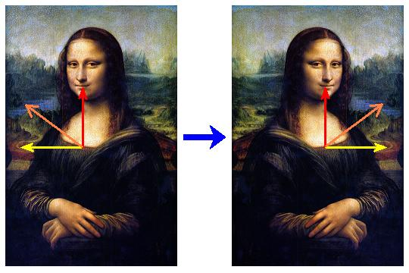
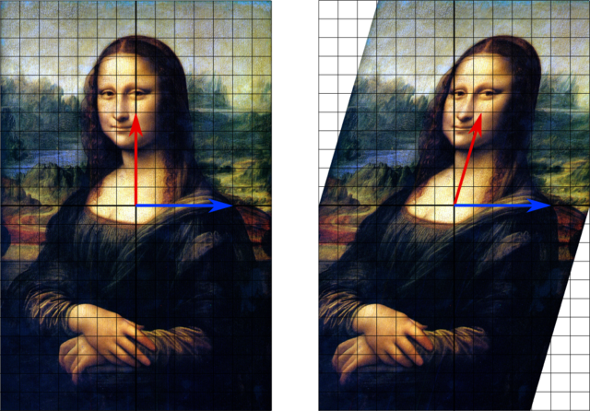
Eigenvectors (cont.)
A1
Which vectors are eigenvectors?
Red
Blue
Which vectors are eigenvectors?
Red
Orange
Yellow
What are the eigenvalues?
A2

Slide 54
PCA and Eigenvectors
For Square Matrix: Data matrix to Covariance matrix
The principal components are sorted in order of decreasing “significance” or strength
From n to k: Since the components are sorted, the size of the data can be reduced by eliminating the weak components (i.e., using the strongest principal components, to reconstruct a good approximation of the original data)
n
n
k
Covariance matrix
A = D^{T}D
D (normalized)
...
N
n
n

Slide 55
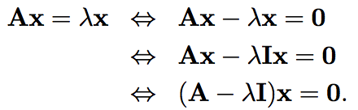
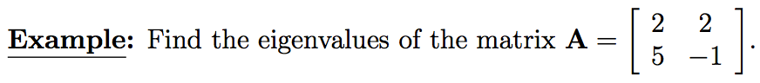
PCA and Eigenvectors (cont.)
Method: Find the eigenvectors of covariance (square) matrix, and these eigenvectors define the new space

Slide 56
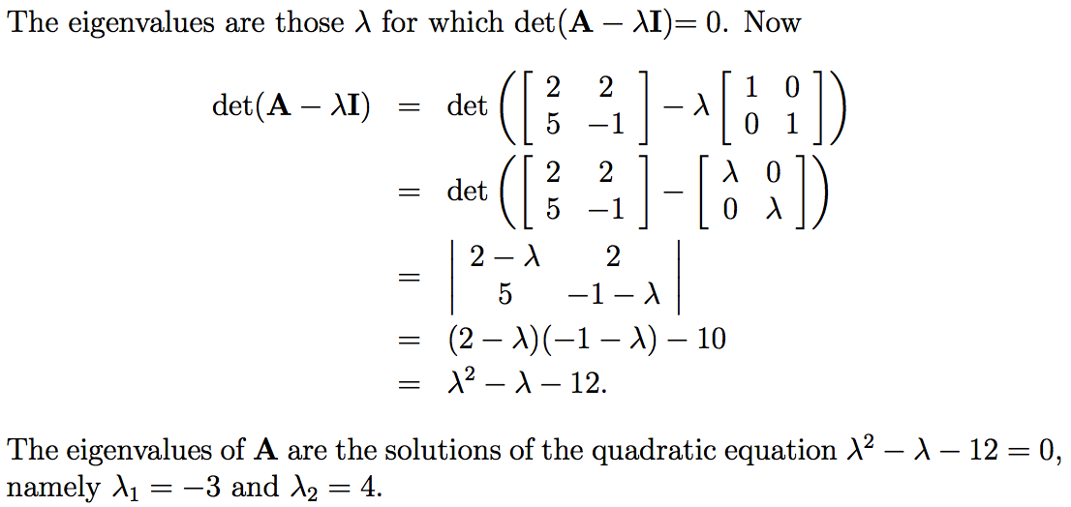
Ex. Eigenvalues

Slide 57
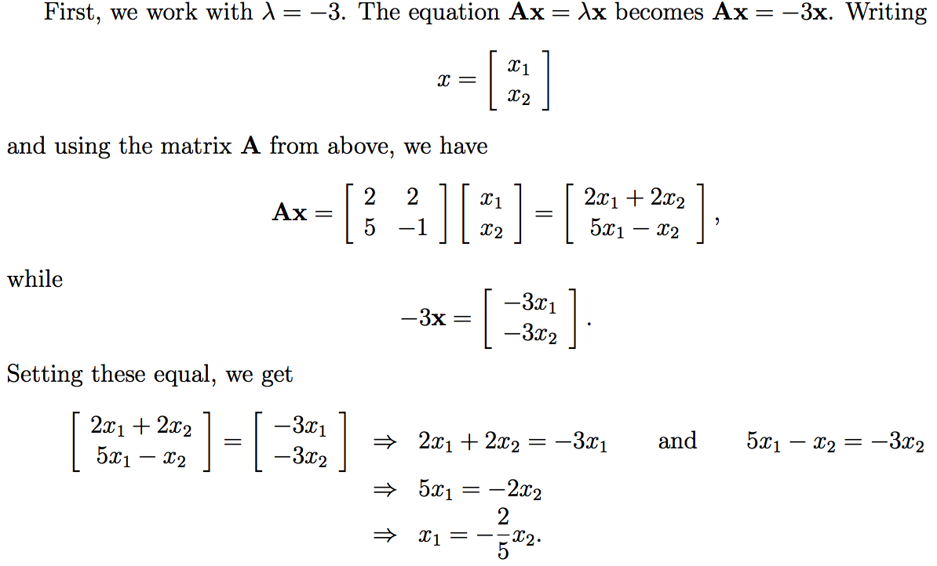
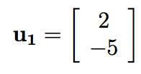
Ex. Eigenvectors

Slide 58
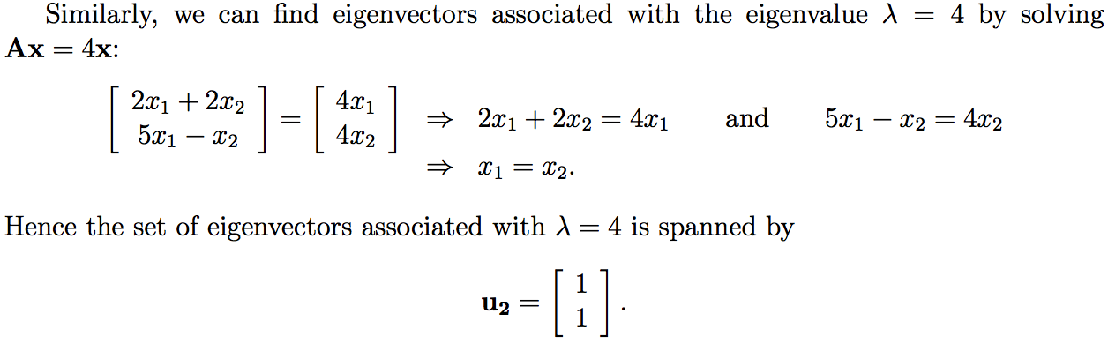
Ex. Eigenvectors (cont.)

Slide 59
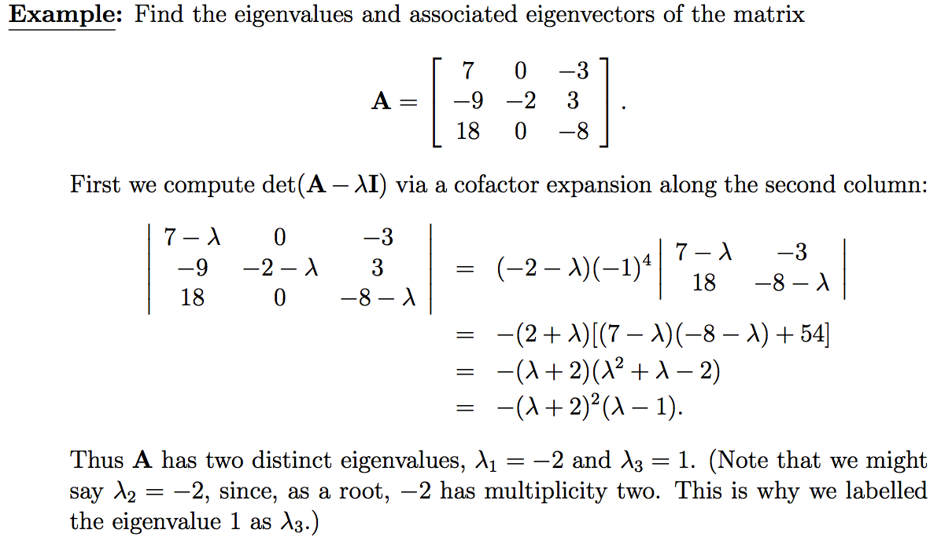
Ex. Eigenvalues (cont.)

Slide 60
Attribute Subset Selection
Another way to reduce dimensionality of data
Redundant attributes
Duplicate much or all of the information contained in one or more other attributes
E.g., purchase price of a product and the amount of sales tax paid
Irrelevant attributes
Contain no information that is useful for the data mining task at hand
Ex. A student’s ID is often irrelevant to the task of predicting his/her GPA

Slide 61
Heuristic Search in Attribute Selection
There are 2^{d} possible attribute combinations of d attributes
Typical heuristic attribute selection methods:
Best single attribute under the attribute independence assumption: choose by significance tests
Best step-wise feature selection:
The best single-attribute is picked first
Then next best attribute condition to the first, ...
Step-wise attribute elimination:
Repeatedly eliminate the worst attribute
Best combined attribute selection and elimination

Slide 62
Summary
Data quality: accuracy, completeness, consistency, timeliness, believability, interpretability
Data cleaning: e.g. missing/noisy values, outliers
Data integration from multiple sources:
Correlation analysis: Chi-Square test, Covariance
Data reduction and data transformation
Normalization: Z-score normalization
Dimensionality reduction
PCA, Heuristic Search in Attribute Selection

Slide 63
References
D. P. Ballou and G. K. Tayi. Enhancing data quality in data warehouse environments. Comm. of ACM, 42:73-78, 1999
T. Dasu and T. Johnson. Exploratory Data Mining and Data Cleaning. John Wiley, 2003
T. Dasu, T. Johnson, S. Muthukrishnan, V. Shkapenyuk. Mining Database Structure; Or, How to Build a Data Quality Browser. SIGMOD’02
H. V. Jagadish et al., Special Issue on Data Reduction Techniques. Bulletin of the Technical Committee on Data Engineering, 20(4), Dec. 1997
D. Pyle. Data Preparation for Data Mining. Morgan Kaufmann, 1999
E. Rahm and H. H. Do. Data Cleaning: Problems and Current Approaches. IEEE Bulletin of the Technical Committee on Data Engineering. Vol.23, No.4
V. Raman and J. Hellerstein. Potters Wheel: An Interactive Framework for Data Cleaning and Transformation, VLDB’2001
T. Redman. Data Quality: Management and Technology. Bantam Books, 1992
R. Wang, V. Storey, and C. Firth. A framework for analysis of data quality research. IEEE Trans. Knowledge and Data Engineering, 7:623-640, 1995

